Slide 1
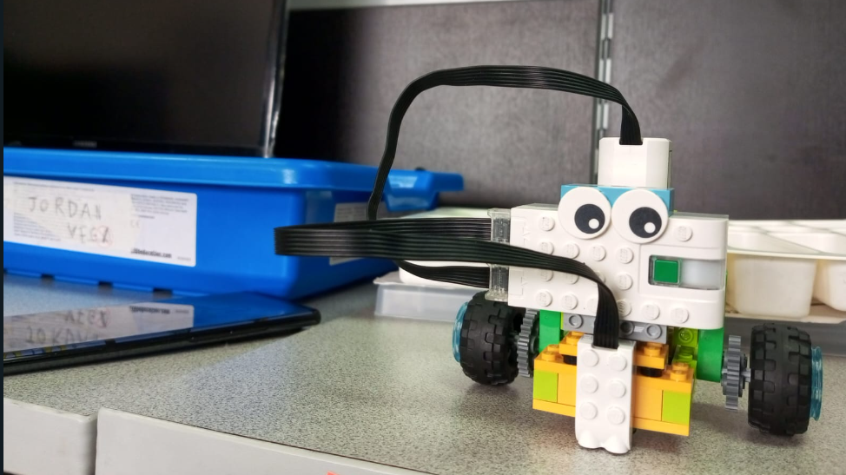
Bimestrial Project Advance I
GRUPO-9 Milton Casnanzuela Marco sQuichimbo

Slide 2
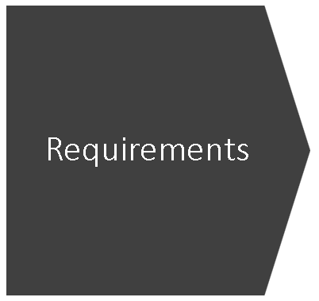
Goals:
1. Teach to child to relate objects through lego game
2. Teach to child how to build a robot with Legos
3. Teach to child how to give instruction in low level
Roles, activities:
David Casnanzuela: tester
Marcos Quichimbo: UX-UI, QA
Materials, technologies
Lego robot
Potential examples:
Lego robot car
Target:
2 – 4 years old
Institution:
Verbose
Julian Galindo: Product Owner
3D printer
Flash cards

Slide 3
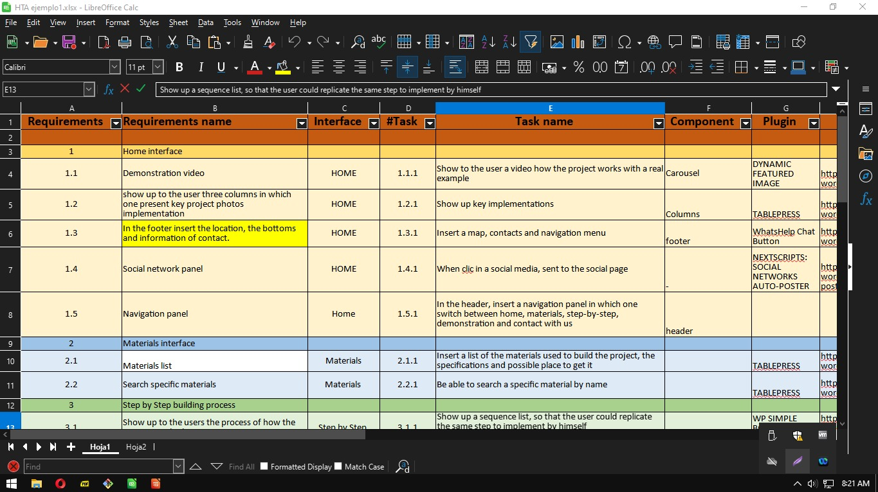
Requirements -> HTA

Slide 4
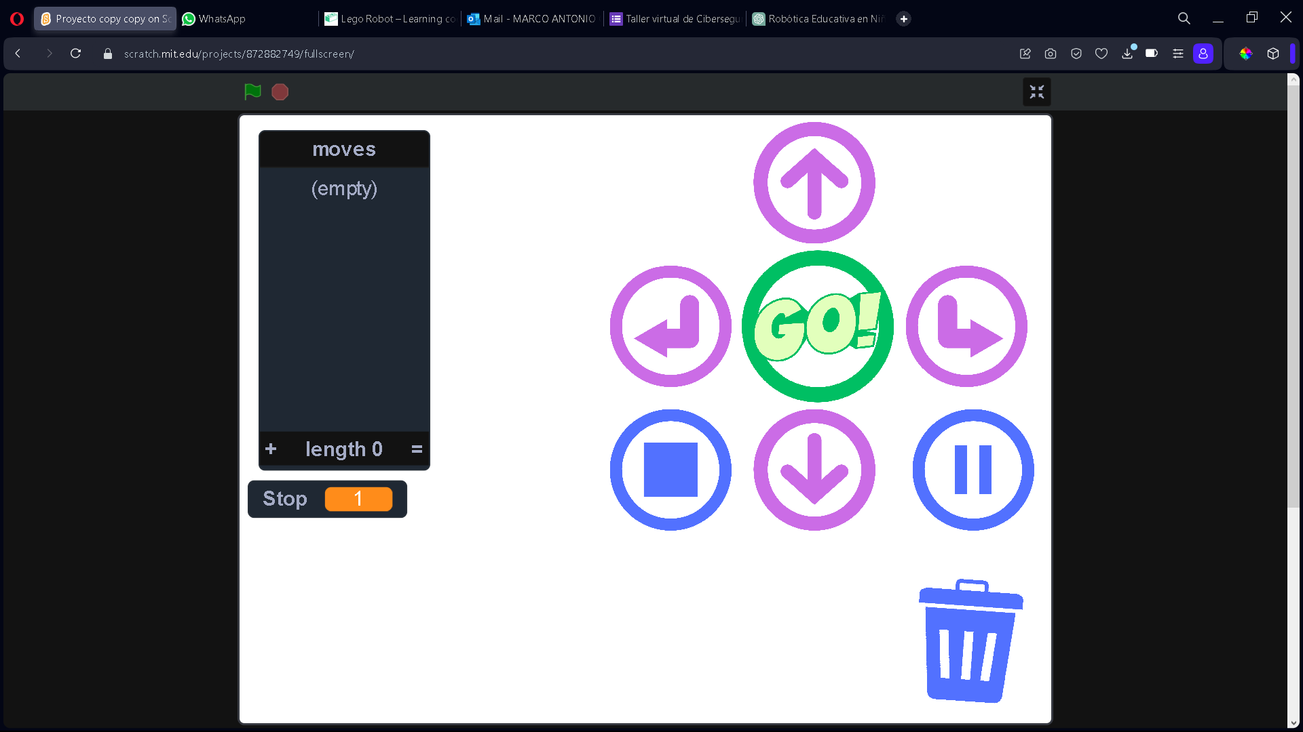
User Interface

Slide 5
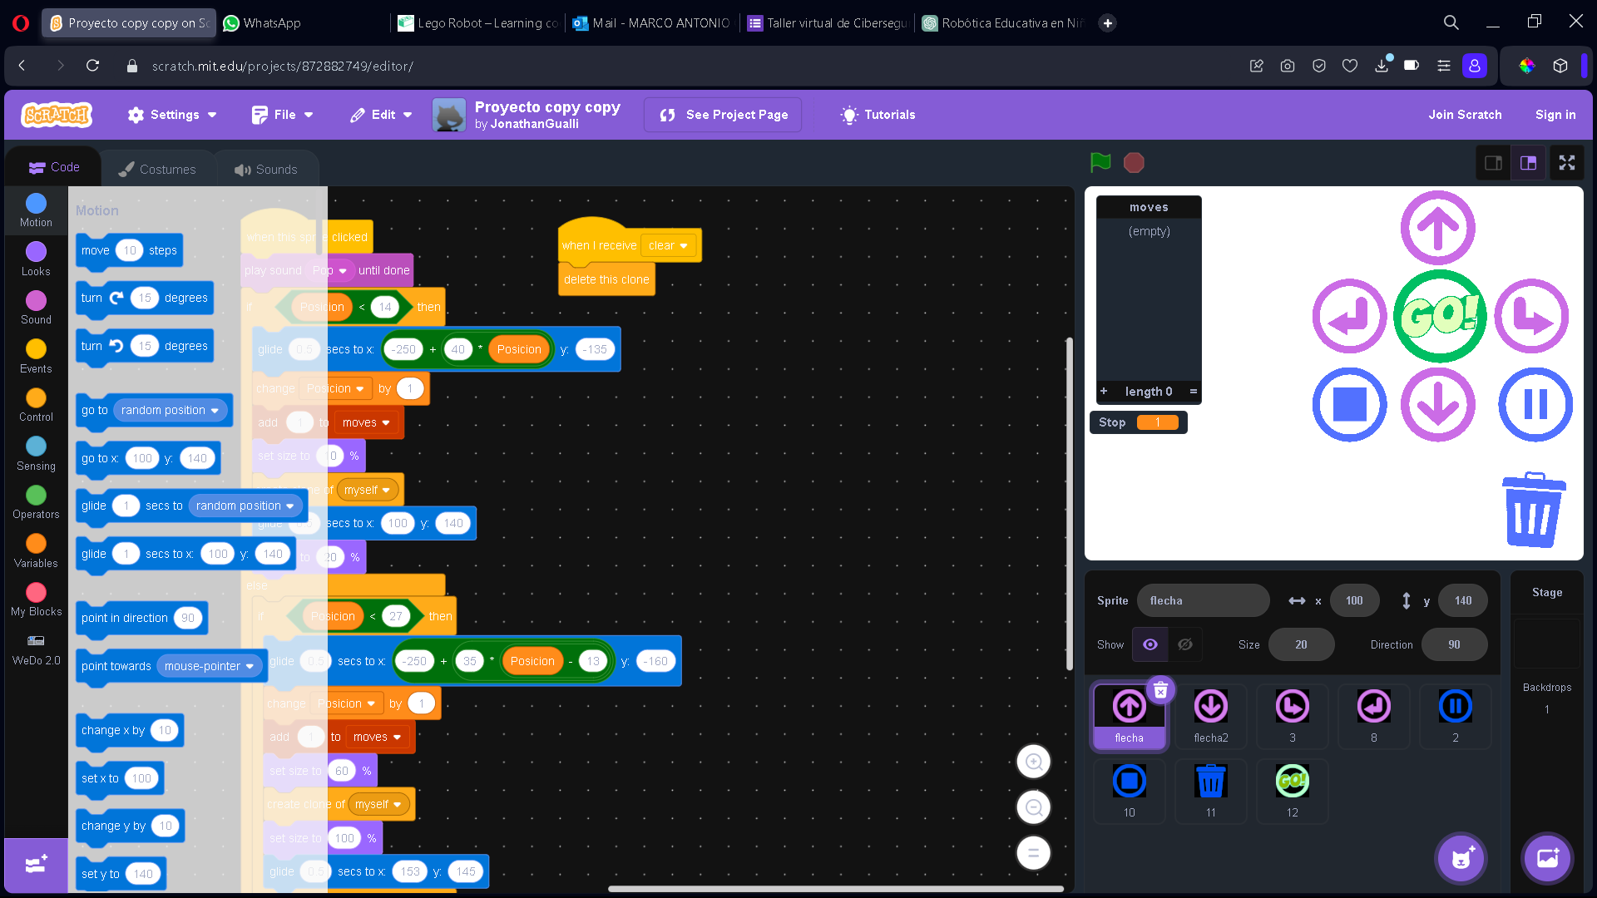
User Interface

Slide 6
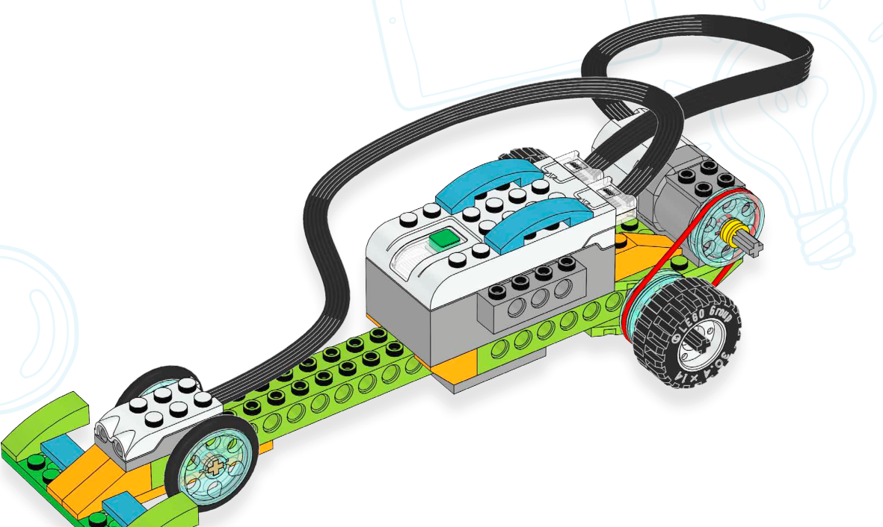
Desing alternatives
F1 Car

Slide 7
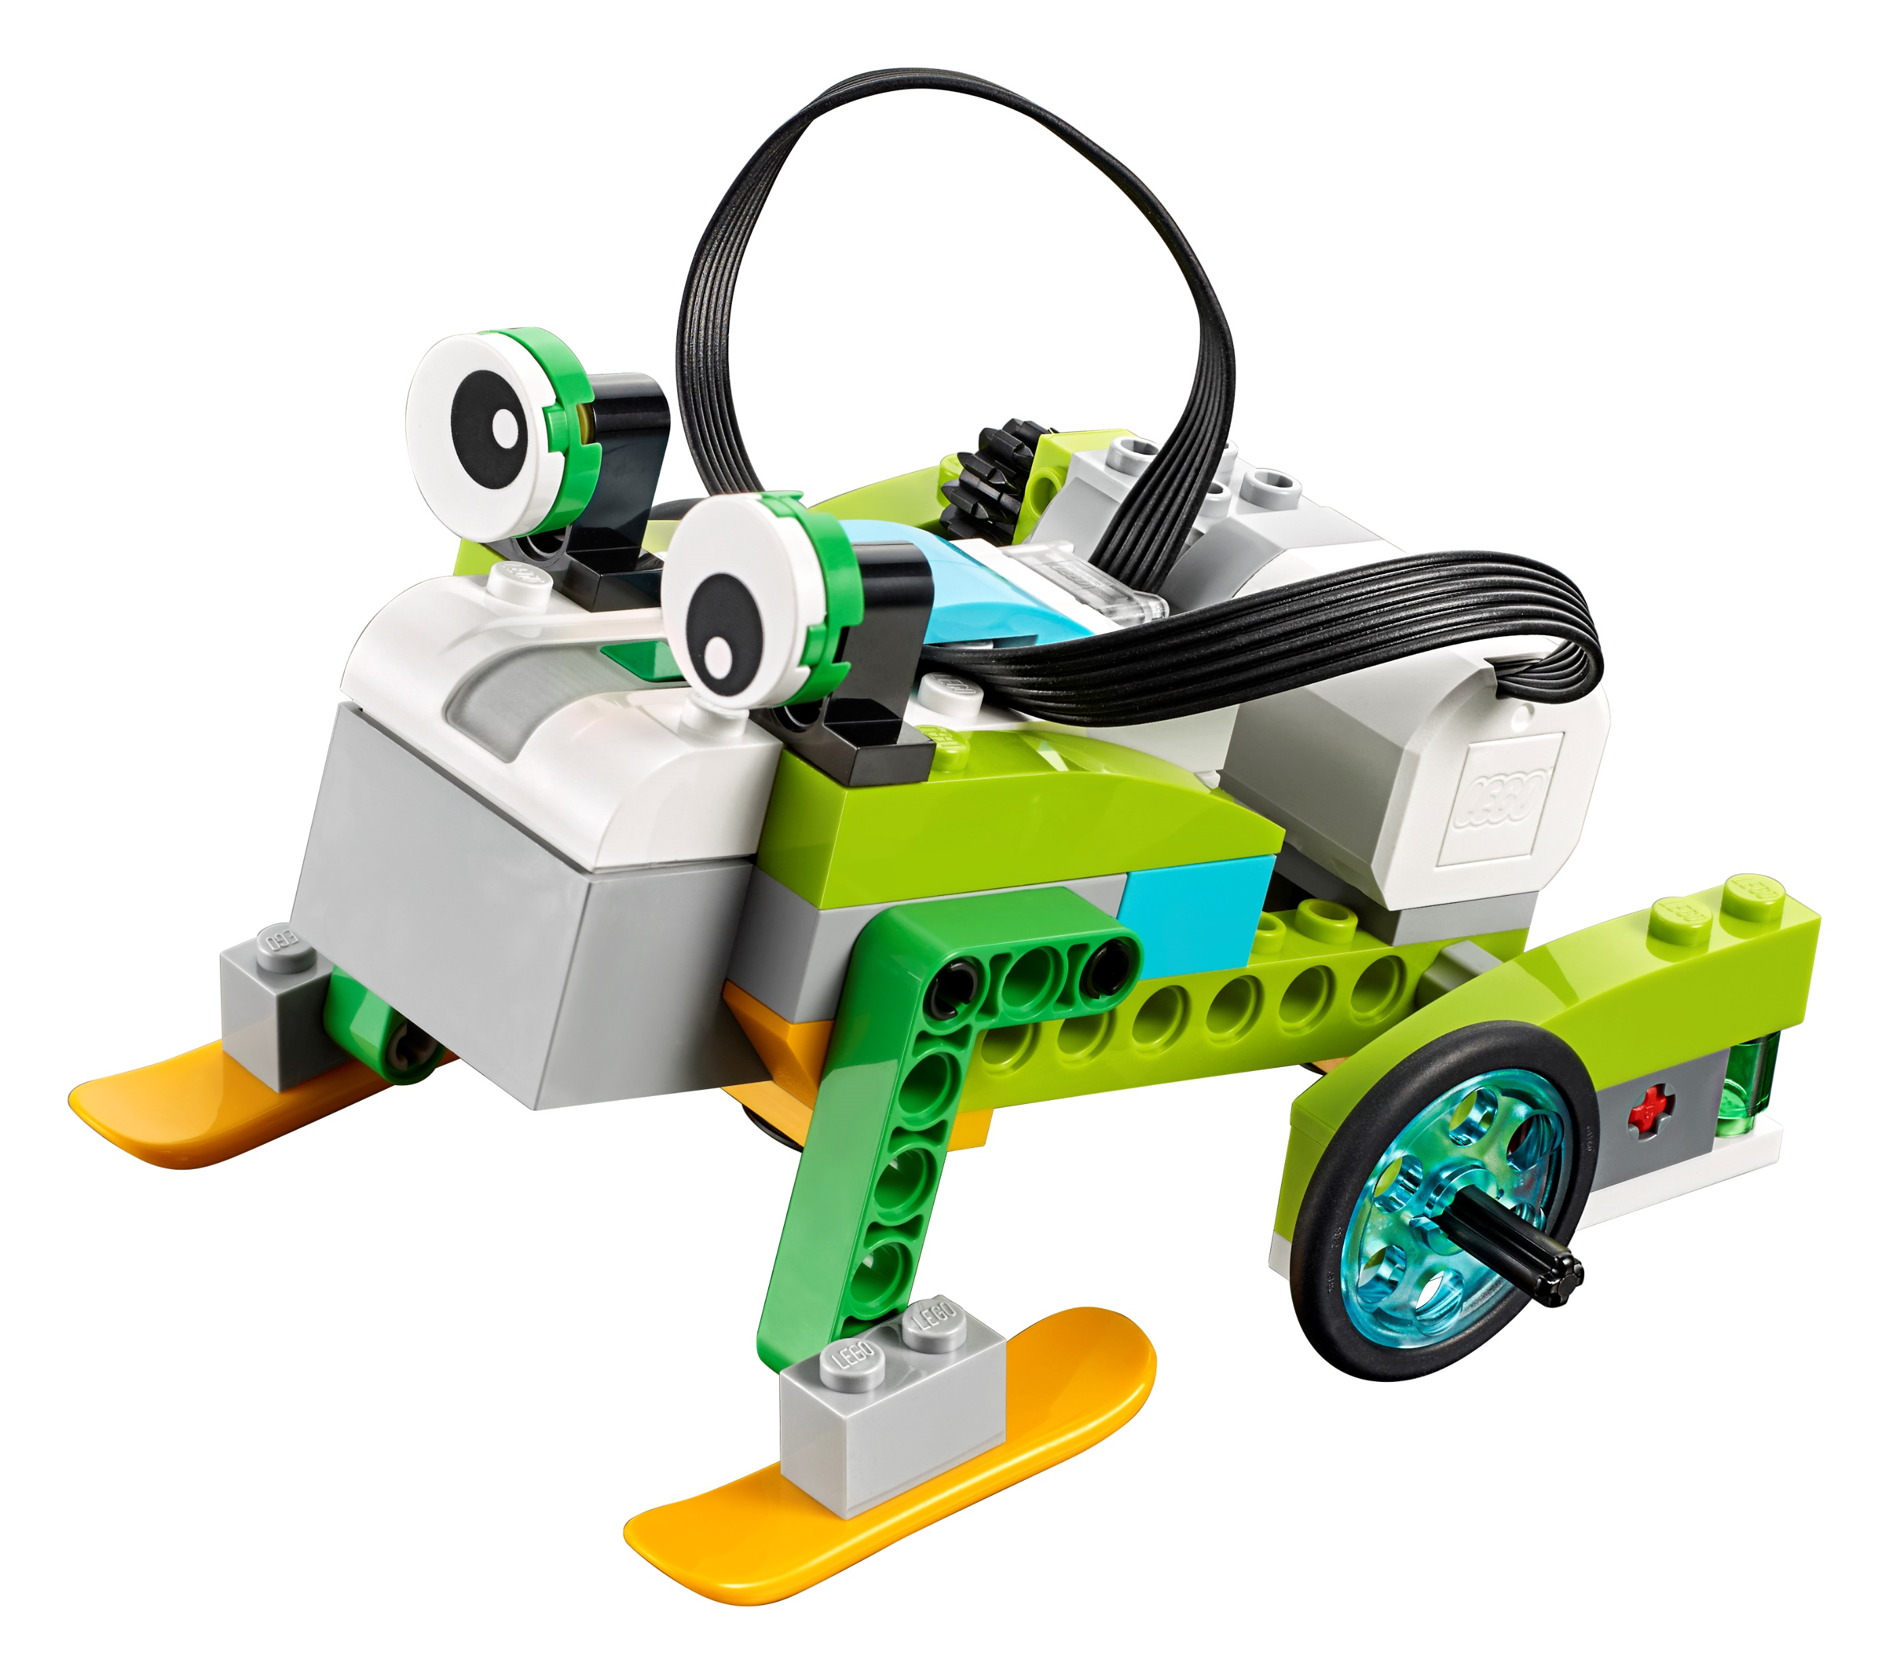
Desing alternatives
Rana segidora

Slide 8
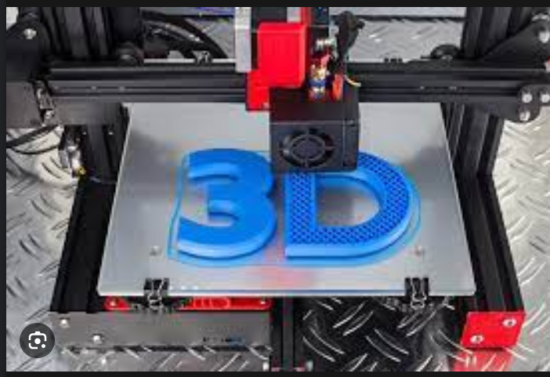
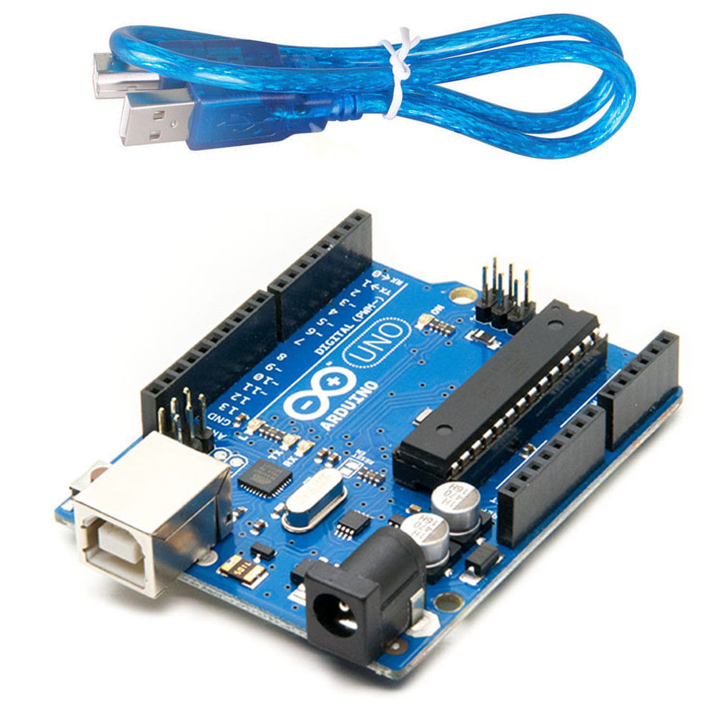
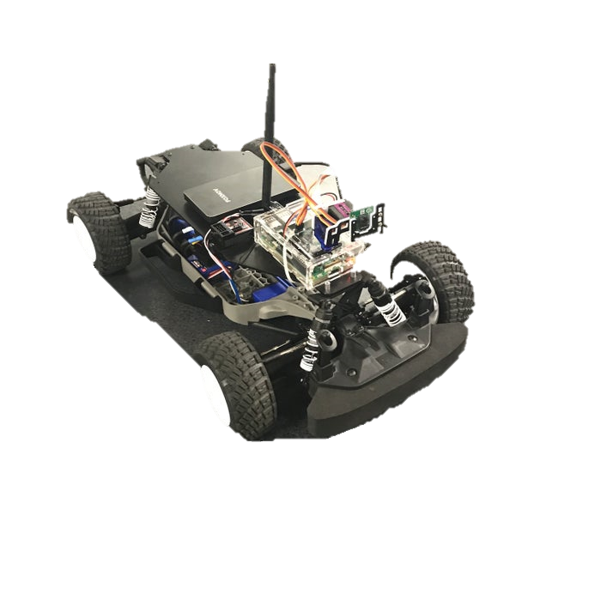
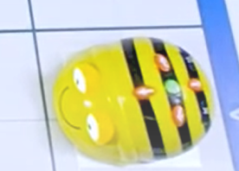
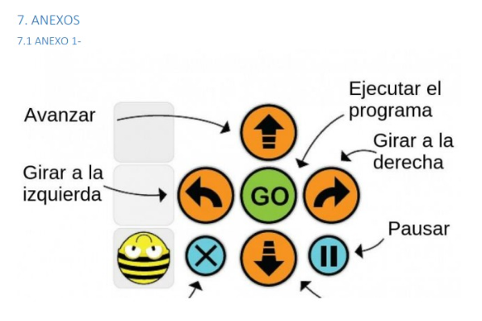
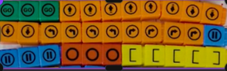








Desing alternatives
Arduino I
Rasberry

Slide 9
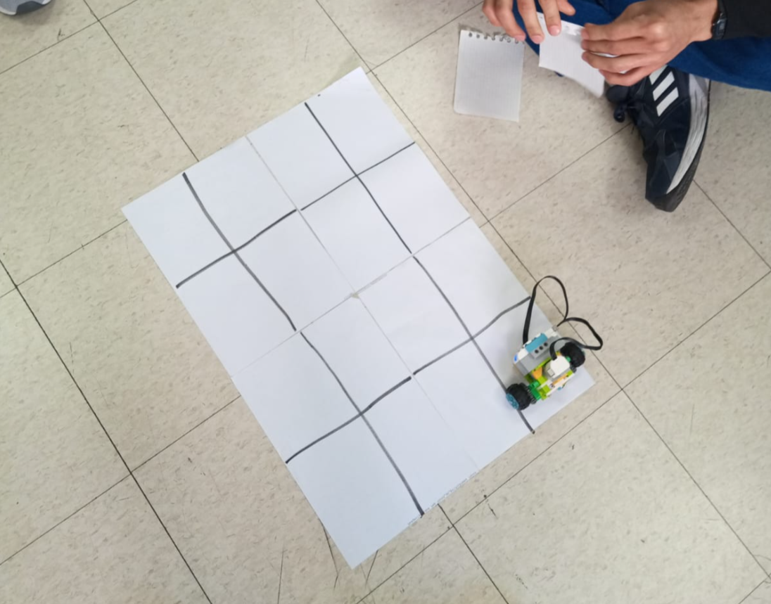
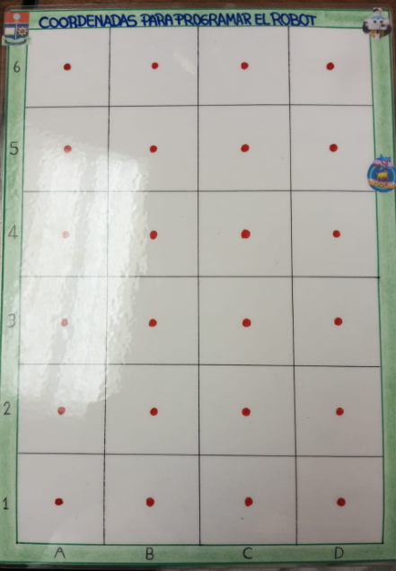




Demo

Slide 10
Prototyping

Slide 11
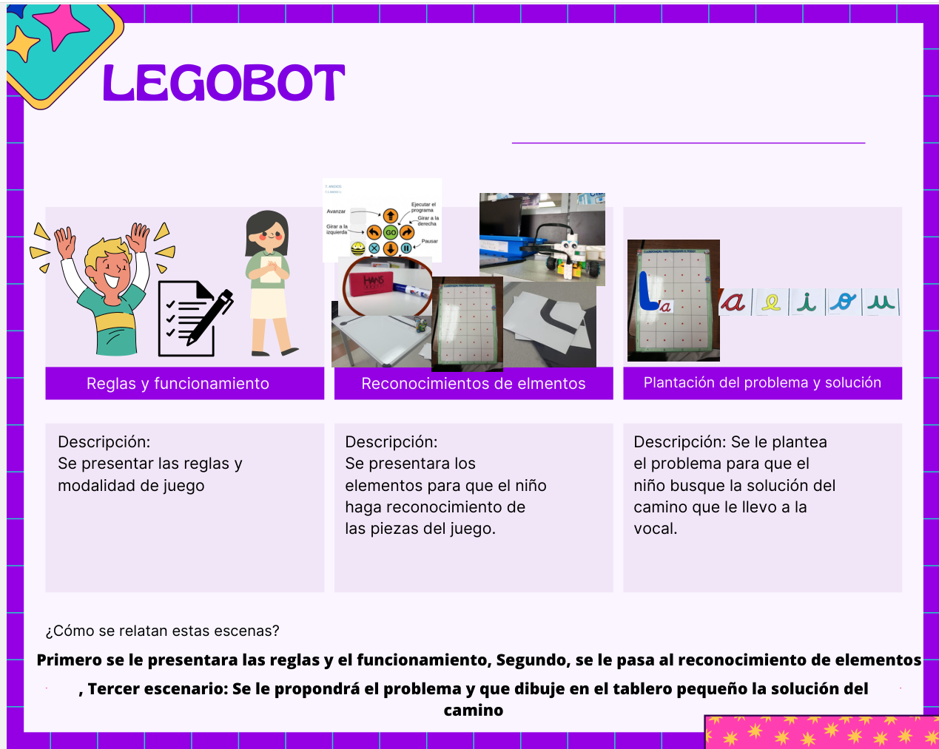

Slide 12
